Slide 1

Navigating the global jobs market: Assessing employability factors in Indian and international engineering graduates
Ahmed Fahzain | Sheth Sarjil | Malek Burhaan

Slide 2
Table of contents
01
02
03
04
05
Abstract
Introduction
Literature Review
Key Points Covered
Context of the Topic
Previous Research Findings
Comparison
Conclusion
Comparative Analysis
Summary of Findings

Slide 3

Abstract
01
Key Points covered.
1. Study Focus
2. Research Approach
Investigating factors influencing the employability of Indian and international engineering graduates in the global job market.
Examining skill sets, educational backgrounds, and industry trends to understand relative employability.
3. Specific Inquiry
4. Overall Objective
Understanding the challenges faced by Indian engineering graduates seeking international employment, including cultural adaptation and language proficiency.
Providing valuable insights and recommendations to enhance the employability of engineering graduates worldwide, addressing educational institutions, policymakers, and industry stakeholders.

Slide 4
Introduction
02
1
Context of the topic
1. Research Objective
2. Recommendations for Improvement
The paper aims to explore employability factors for Indian and international engineering graduates, offering strategies for global enhancement.
Proposals include measuring learning outcomes explicitly, engaging accreditation agencies actively, and implementing nationwide quality enhancement initiatives.
3. Global Employment Challenges
Surveys indicate significant dissatisfaction among employers, with 64% expressing moderate satisfaction or worse.

Slide 5
Introduction
02
2
Context of the topic
4. Shared Concerns
5. Understanding Differences
The paper aims to explore employability factors for Indian and international engineering graduates, offering strategies for global enhancement.
Exploring the varied factors that affect employability for engineering graduates from different backgrounds.
6. Bridging Educational-Industry Gap
The study helps engineering graduates worldwide be better prepared and more competitive by matching what they learn with what companies need.

Slide 6


Literature Review
03
Previous Research Findings
This dissatisfaction is supported by previous studies, such as a 2005 report by NASSCOM and McKinsey, which revealed that 75% of Indian engineering graduates were considered unemployable by multinational corporations.
Core Employability Skills, including integrity, teamwork, and willingness to learn, are identified as crucial, contributing to over 85% of the total skill variance.

Slide 7


Data collection efforts resulted in a distribution of approximately 58% male respondents and 42% female respondents, reflecting a balanced gender representation in the research sample.
BSc IT emphasizes technology usage in businesses, while BCA strengthens skills in software solutions development, enabling students to align their education with their career goals.

Slide 8


India boasts a vast infrastructure comprising over 40,000 higher educational institutions, including 800 universities, 3,500 engineering colleges, and 5,000 management colleges.
Engineering institutions experienced an increase in enrollments from 3,222 in the academic year 2010–11 to a peak of 3,495 in 2012–13, followed by a marginal decrease to 3,288 enrollments in 2016–17.

Slide 9
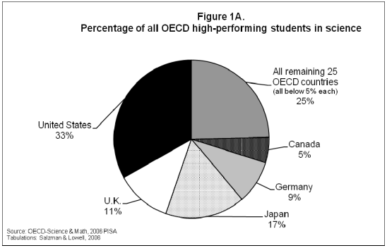
In the realm of technology education, the United States stands out as a global leader, boasting an exceptional cohort of high-achieving students whose accomplishments often surpass those of their peers in other countries. Despite the vast economic and social diversity within the nation, the USA maintains an extraordinary pool of excellent science students.
Over the past three decades, the United States has consistently demonstrated a significant percentage of top-performing students in the field of science, showcasing remarkable stability and excellence. This consistent performance is a testament to the nation's commitment to fostering talent and nurturing a culture of innovation and academic excellence.
The United States' consistent success in producing exceptional science graduates has created a challenge: a growing population has led to more graduates than available jobs in science and engineering sectors. This underscores the importance of aligning educational initiatives with workforce demands and creating pathways for talented individuals to contribute to technological advancement.

Slide 10
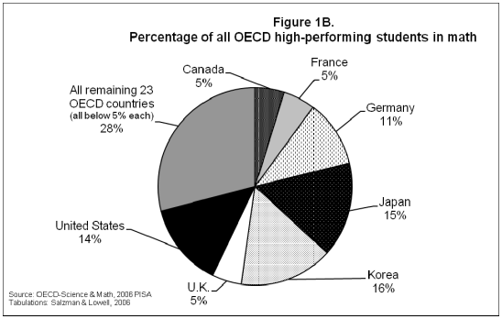
The United States holds the second position worldwide, following Japan, in producing top-performing math students, signifying remarkable proficiency and excellence.
Despite the nation's diverse demographics, its unparalleled prowess in mathematics among industrialized countries remains a consistent achievement.
Over time, the United States has demonstrated a steady production of highly skilled math students, contributing to the population of exceptional graduates; however, this surplus talent poses a challenge in effectively aligning it with available opportunities in the mathematics field and related industries.

Slide 11

In China and India, recent engineering graduates face a paradox: high unemployment despite strong demand. A McKinsey survey showed low global employability rates for Chinese and Indian engineers. Barriers to employment include education quality and cultural disparities.
Researchers interviewed MNCs hiring top engineering graduates and visited R&D centers. These interactions provided insights into post-baccalaureate challenges. The data completion gave a comprehensive understanding of workforce entry hurdles.
In India, IT graduates lack crucial employability skills like communication and problem-solving. These competencies are vital for job readiness and competitiveness. Failure to address this gap could hinder the growth of India's IT sector.

Slide 12

The deficiency of employability talents among Indian IT graduates poses a significant threat to the global competitiveness of the country's IT industry. Without readily employable professionals, the industry may struggle to maintain its edge in a rapidly evolving global market.
Alignment between industry needs and graduates' skills is crucial for innovation and meeting global demands. Without essential employability skills, the Indian IT sector risks falling behind in technological advancement and market responsiveness.
As automation reshapes job opportunities, engineering graduates must adapt to the demands of the fourth industrial revolution (4IR) to ensure their employability. Failing to acquire relevant skills early on could lead to unemployment in an evolving job market.

Slide 13

Engineering firms face challenges in teamwork and communication due to the individual-focused nature of engineering education. Graduates often lack crucial non-technical skills like effective communication and collaboration.
International engineering Master's students need skills such as information management, inquisitiveness, and problem-solving abilities. These competencies are vital for addressing complex tasks and proposing innovative solutions.
In today's interconnected world, engineers must transcend technical prowess to understand interdisciplinary relationships. By fostering collaboration across disciplines, engineers can contribute more effectively to complex projects and adapt to the evolving demands of the industry.

Slide 14
Comparison
04
Comparative Analysis
Communication | Problem Solving | Time Manage. | Technical Skills | Teamwork
11 | 7 | 5 | 8 | 7
Communication
Ranked highest among employers, highlighting its critical importance in the workplace. Indicates a strong emphasis on the ability to convey ideas effectively and interact with others..
Problem Solving
Signifies the value placed on individuals who can identify issues and devise solutions. Indicates a significant need for analytical thinking and adaptability.

Slide 15
Time Management
While slightly lower in rank, it still underscores employers' recognition of the importance of managing tasks and deadlines efficiently. Suggests a need for candidates who can prioritize and organize their workload effectively.
Technical Skills
Reflects the demand for expertise in specific areas such as technology, tools, or methodologies. Indicates a considerable reliance on specialized knowledge in the current job market.
Teamwork
Emphasizes the importance of collaboration and interpersonal skills in achieving organizational objectives. Indicates a strong preference for candidates who can work effectively in group settings.

Slide 16
Conclusion
05
Summary Of Findings
The review paper concludes the necessity for a comprehensive approach to skill development in engineering education and training programs.
It emphasizes the importance of integrating soft skills such as communication, teamwork, critical thinking, and decision-making alongside technical expertise based on the analysed papers.
Furthermore, our review paper highlights the need for engineering graduates to possess the ability to address complex challenges and holistic skill sets encompassing adaptability, creativity, and problem-solving acumen, as indicated by the referenced literature.
Ultimately, the review paper underscores the goal of ensuring the readiness of graduates to thrive in a dynamic and interconnected global job market, where the demands on engineering roles are continuously evolving, drawing insights from the reviewed literature.

Slide 17
Thank You!
Ahmed Fahzain Rizwan
saiyedfahzain191@gmail.com
Sheth Sarjil
sarjilark123@gmail.com
Malek Burhaan
malekburhaan@gmail.com

